Slide 1
Project name: electronic marking Project team: esraa Samir – arwa moahmed saed SECTION: 2

Slide 2
The project aimed to develop exams system by making correction electronic.
The site is created to receive students' answers and correct them easy, fast, and fair. It also will display the results at the end.
Paper correction take a lot of time so this project will save time and efforts.

Slide 3
work Breakdown Structure:
We’re breaking down project components into smaller. ​
System Design
Requirements Specification
System Development
System Testing
Apply Coding
Debug Coding
Component Testing
User Testing
Acceptance Testing
System Installation
System Deployment
User training
Support & Maintenance
Post Implementation review
Requirements Analysis
Interface Prototypes
WBS

Slide 4
Responsibilities matrix:
Identify all the roles within a project and the associated responsibilities to the project work.
Tasks | Project Manager | Project Sponsor | Project Team | Programmers | Finance Team
Made the Initial plan | R |  | C
Budget | R | S |  |  | C
Create The System | A | S | C | R
Test the system | A |  | R
Identified the risk and problems |  |  | R | C
Solve the problem | A | S | R | R
Reports & Analysis | R | C

Slide 5
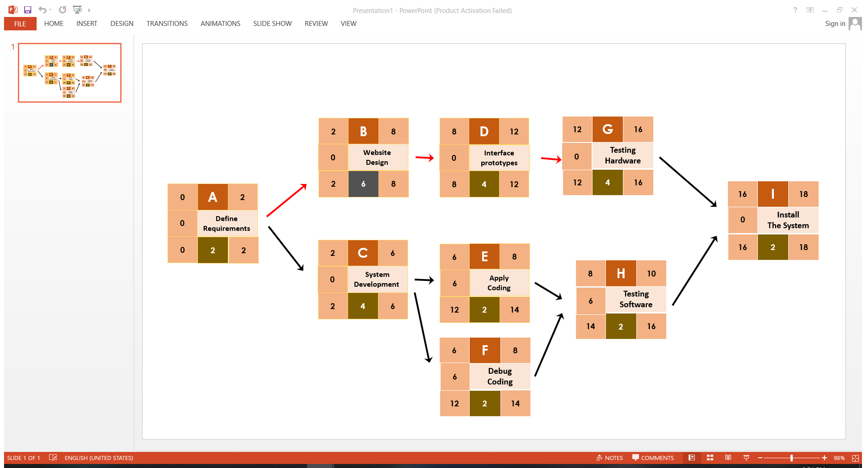
Project Network:
The activities that must be completed, the logical sequences, the interdependencies of the activities to be completed.

Slide 6
Resource Constrained project:
Prioritize and allocate resources to minimize project delay without exceeding the resource limit.
ID | RES | DUR | ES | LF | SL | 0 | 1 | 2 | 3 | 4 | 5 | 6 | 7 | 8 | 9 | 10 | 11 | 12 | 13 | 14 | 15 | 16 | 17 | 18 | 19
A | 2P | 2 | 0 | 2 | 0 | 2 | 2
B | 2P | 6 | 6 | 12 | 0 |  |  |  |  |  |  | 2 | 2 | 2 | 2 | 2 | 2
C | 2P | 4 | 2 | 6 | 0 |  |  | 2 | 2 | 2 | 2
D | 1P | 4 | 8 | 12 | 0 |  |  |  |  |  |  |  |  | 1 | 1 | 1 | 1
E | 1P | 2 | 6 | 14 | 6 |  |  |  |  |  |  | 1 | 1
F | 1P | 2 | 16 | 18 | 6 |  |  |  |  |  |  |  |  |  |  |  |  |  |  |  |  | 1 | 1
G | 1P | 4 | 12 | 16 | 0 |  |  |  |  |  |  |  |  |  |  |  |  | 1 | 1 | 1 | 1
H | 1P | 2 | 18 | 20 | 6 |  |  |  |  |  |  |  |  |  |  |  |  |  |  |  |  |  |  | 1 | 1
I | 1P | 2 | 16 | 18 | 6 |  |  |  |  |  |  |  |  |  |  |  |  |  |  |  |  | 1 | 1
Total Resource Load |  |  |  |  |  | 2P | 2P | 2P | 2P | 2P | 2P | 3P | 3P | 3P | 3P | 3P | 3P | 1P | 1P | 1P | 1P | 1P | 1P | 1p | 1P
Resource Available |  |  |  |  |  | 3P | 3P | 3P | 3P | 3P | 3P | 3P | 3P | 3P | 3P | 3P | 3P | 3P | 3P | 3P | 3P | 3P | 3P | 3p | 3P

Slide 7
Baseline budget:
ID | Task | Budget | 0 | 1 | 2 | 3 | 4 | 5 | 6 | 7 | 8 | 9 | 10 | 11 | 12 | 13 | 14
A | Define Requirements | 20 | 10 | 10
B | Website Design | 50 |  |  |  |  |  |  | 20 | 10 | 20
C | System Development | 60 |  |  | 10 | 20 | 20 | 10
D | Interface Prototypes | 30 |  |  |  |  |  |  |  |  | 10 | 10 | 10
E | Apply Coding | 50 |  |  |  |  |  |  | 25 | 25
G | Debug Coding | 40 |  |  |  |  |  |  |  |  | 20 | 20
G | Testing Hardware | 25 |  |  |  |  |  |  |  |  |  |  | 15 | 10
H | Testing Software | 25 |  |  |  |  |  |  |  |  |  |  | 15 | 10
I | Install The System | 40 |  |  |  |  |  |  |  |  |  |  |  |  | 20 | 10 | 10
Total |  | 340 | 10 | 10 | 10 | 20 | 20 | 10 | 45 | 35 | 50 | 30 | 40 | 20 | 20 | 10 | 10
Commutative |  |  | 10 | 20 | 30 | 50 | 70 | 80 | 125 | 160 | 210 | 240 | 280 | 300 | 320 | 330 | 340

